Slide 1
Crowd Funding Project- Excel Dashboard

Slide 2
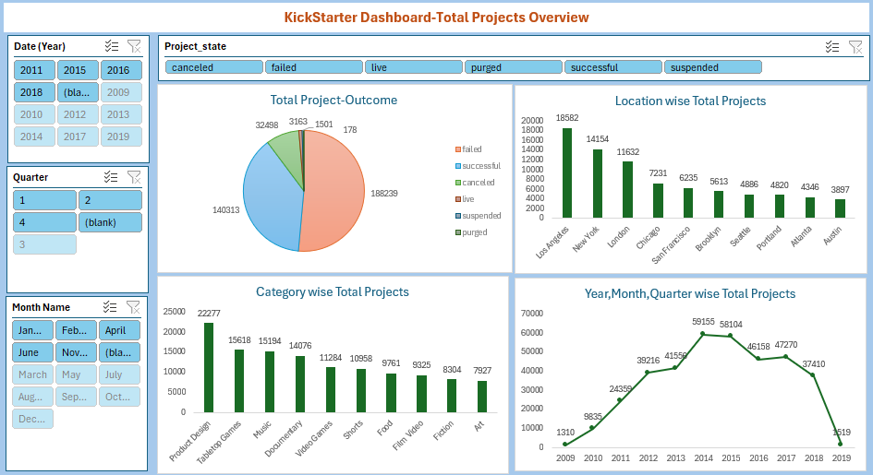

Slide 3
